Slide 1
Sweet Home, Oregon
JACOBS - What we do for you!
8-28-2018

Slide 2
Sweet Home Overview

Slide 3
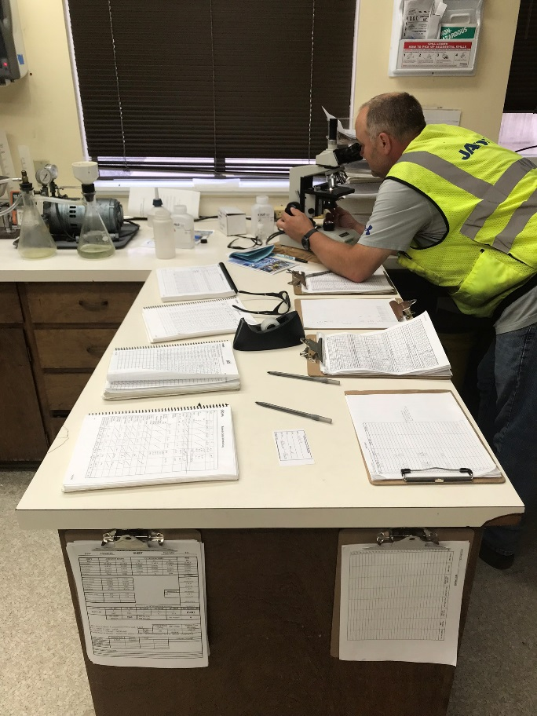
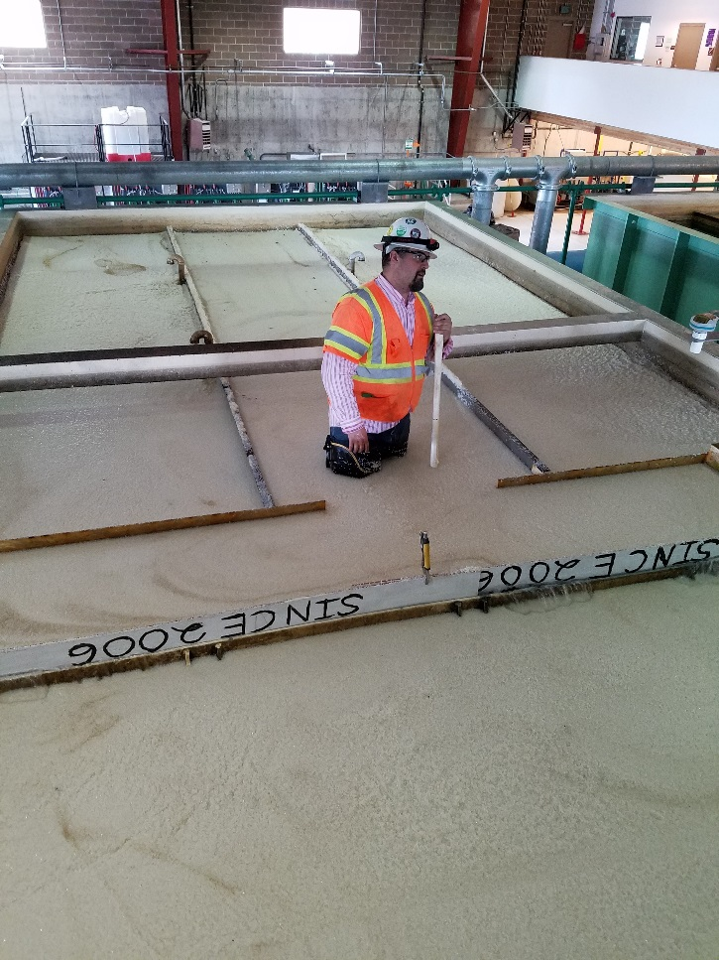
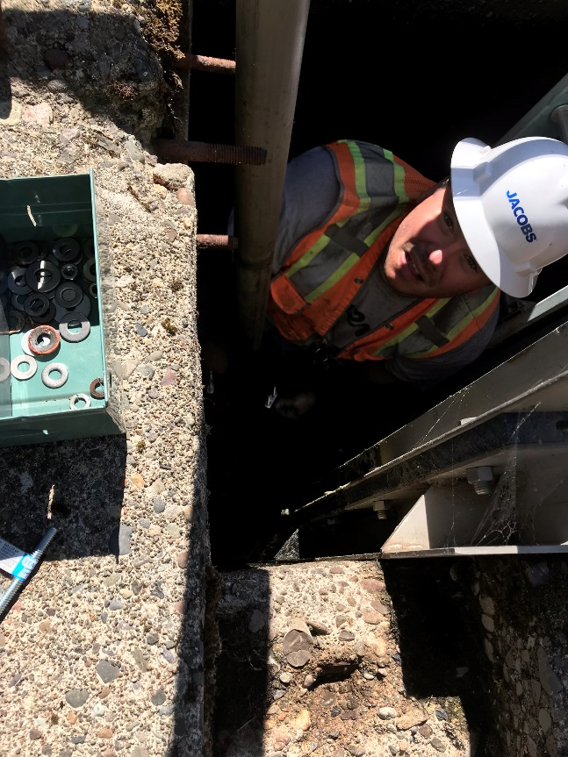
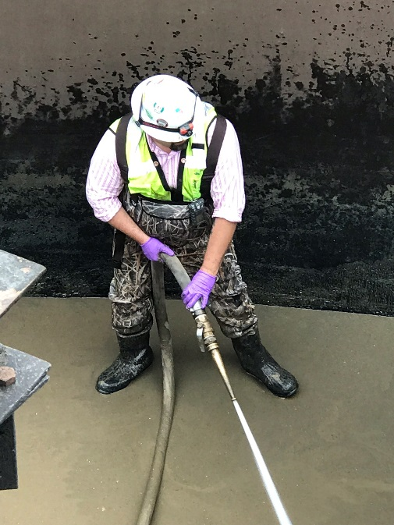

Slide 4
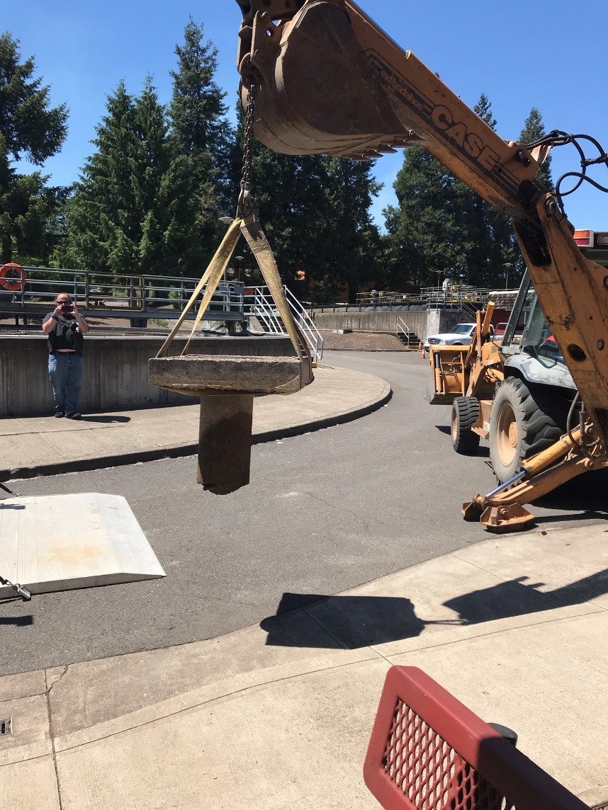
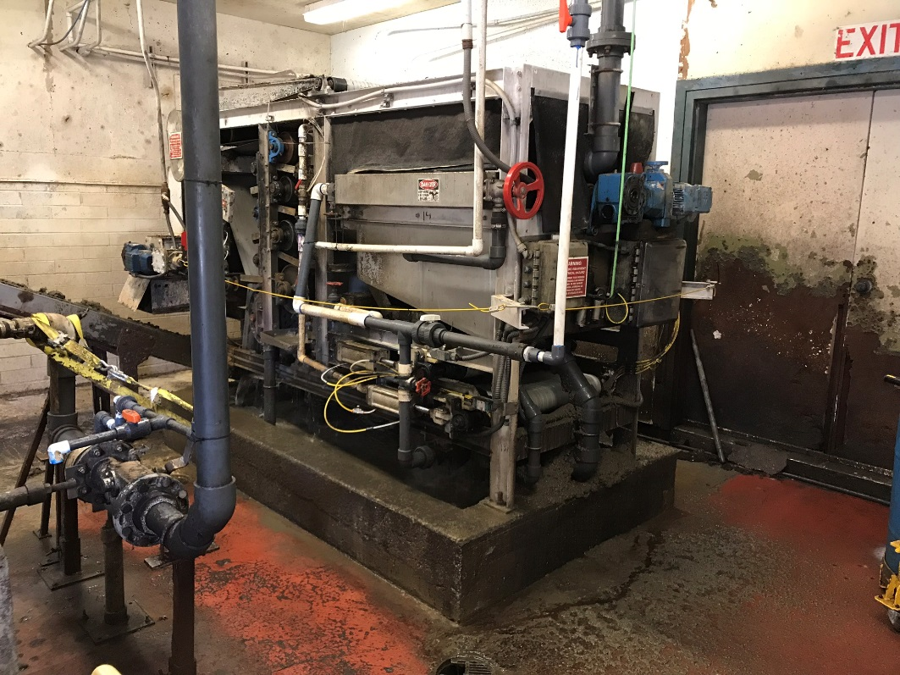

Slide 5
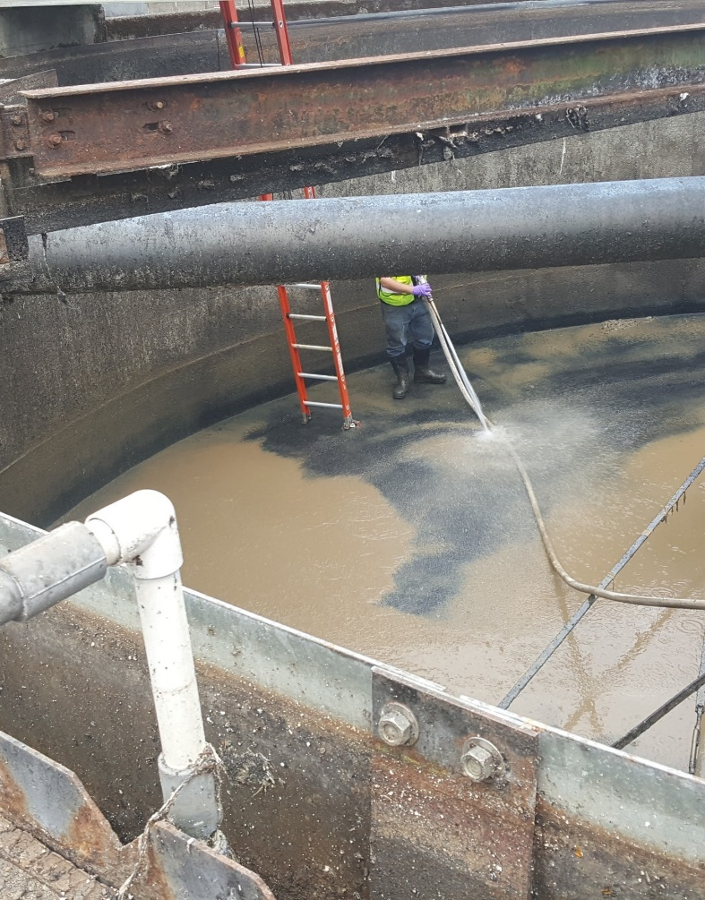
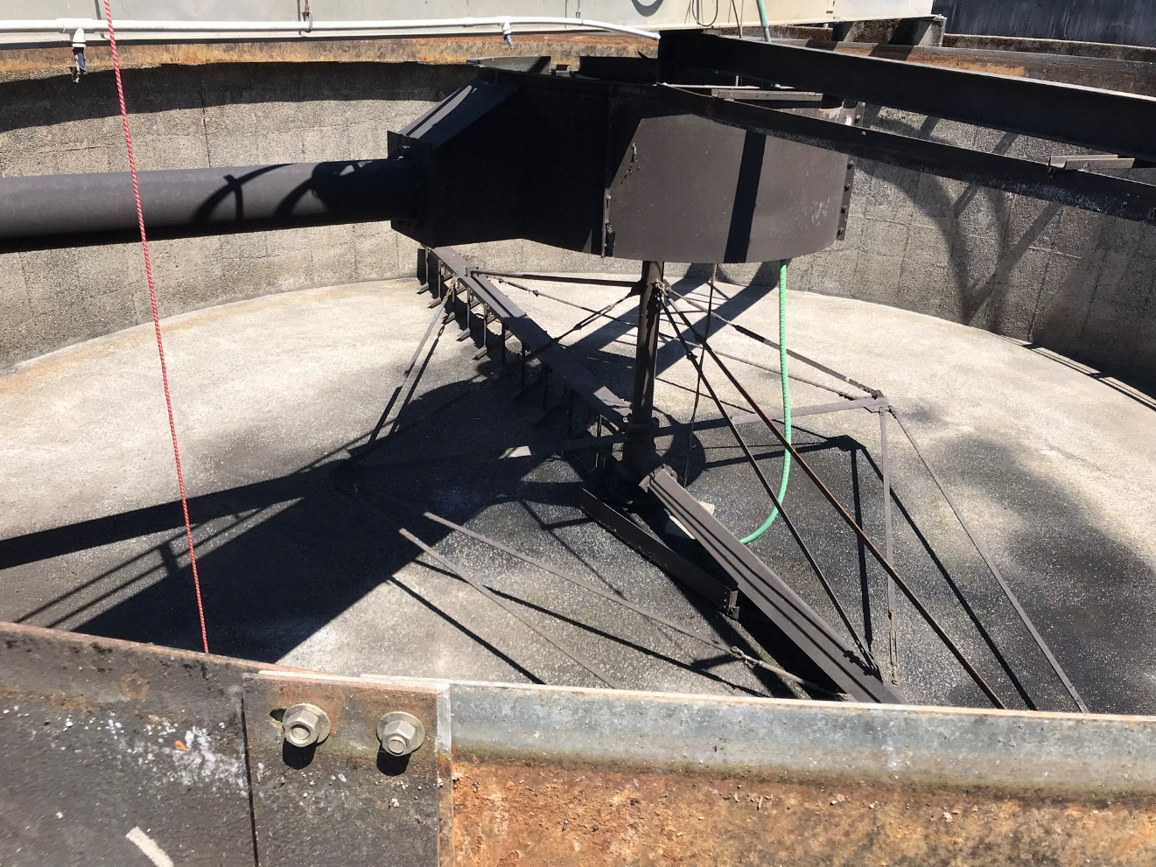

Slide 6
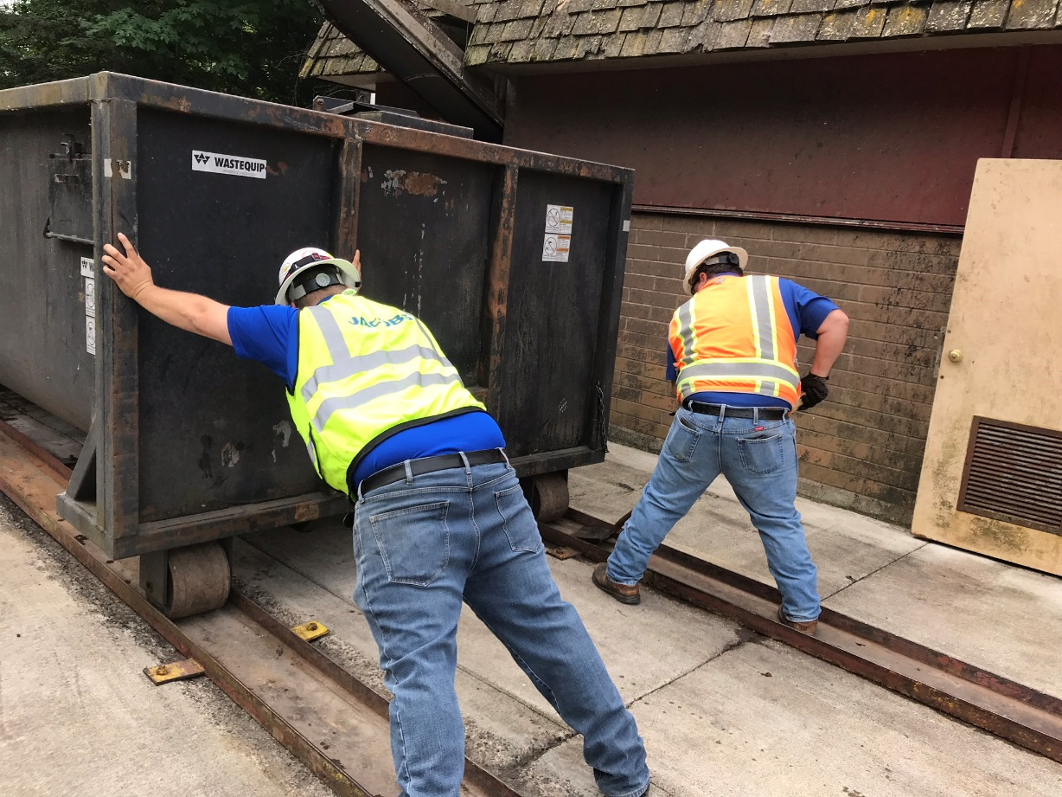
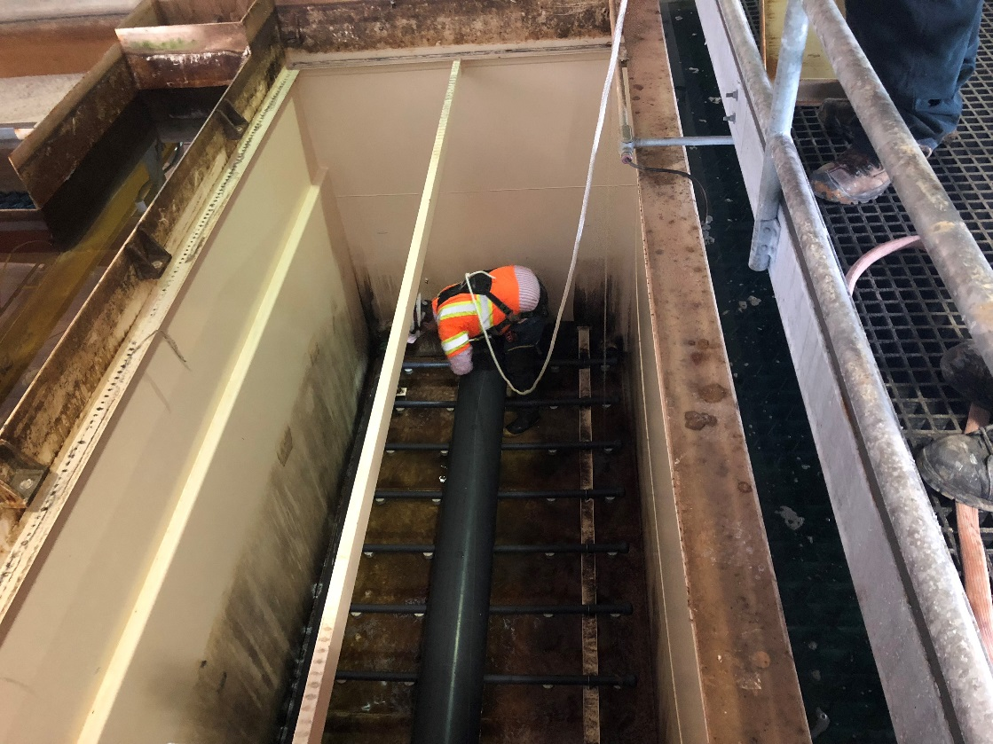

Slide 7
Labor
17/18 Contract Year
Local Labor $315,000
Regional Support $75,000
Total Labor dollars $390,000

Slide 8
Chemicals Budgeted
S02 $24,000
Cl2 $25,000
WT Polymer $1,500
WW Polymer $10,000
Salt, Fluoride, HCL, SodaAsh $22,000
Total $82,500

Slide 9
Solids Handling
Actual Hauling Costs to Sweet Home Sanitation
$101,000 (17/18 contract year)
In addition Sweethome paid 45K in out of scope solids hauling

Slide 10
Electrical Costs
$130,000

Slide 11
Work Orders
Corrective Maintenance 171
Preventative Maintenance 1682
Safety work Orders 566

Slide 12
Drinking Water Requirements
Prepare and submit Monthly Operating and Fluoride reports
Maintain Cl2 residual as water enters distribution system
Maintain pH within regulatory standards and to help reduce corrosion in the distribution system
Lead and copper testing (Value added)

Slide 13
WWTP Permit Compliance
Prepare and submit Daily Monitoring Report(DMR) to DEQ Monthly
cBOD/TSS prep and send to Lebanon weekly
pH on effluent 3 times weekly
E-Coli, sample and send to Lab 2x weekly
Maintain SO2 to remove Cl2 before discharge to River
(other various procedures and tests)

Slide 14
Challenges
WTP nearing 10 years since commissioning
Odor Complaints – Being a good neighbor
Equipment and infrastructure beyond design life at WWTP (constant failures)
Cyanotoxins
Ever tightening regulation
Dealing with Regulators both DEQ and OHA

Slide 15
Questions?

